Slide 1



A Text Classification Method with an Effective Feature Extraction based on Category Analysis
Li Yun Sheng Yan Luan Luan

Slide 2
Outline
Introduce & Backgrounds
Feature Extract Strategy
Text Classification Algorithm with an Effective Feature Extraction based on Category Analysis
Experiments and Analysis
2009.08.14
Institute of Information Engineering,Yangzhou University, Jiansu Yangzhou

Slide 3
Introduce & Backgrounds
Automatic classification has become an important research domain in data mining with high commercial value. Simply, the main task of text classification[1] is that, classifier construct by given classification system automatically confirms the category of an unknown text based on its content.
Usually the text contains lots of features and the dimension of vector space is high, which costs much time or space of classifying texts. So we need the methods of feature extract or feature select to obtain the more useful and less features without losing any knowledge as much as possible.
2009.08.14
Institute of Information Engineering,Yangzhou University, Jiansu Yangzhou

Slide 4
Introduce & Backgrounds
We can see that, in order to get better feature vector space, there are two ways:
1) Based on statistical properties of every feature, universal or noise feature need be removed in order to reserve the significative feature;
2) Analyzing the category information to obtain the category contribution of every feature can get hold of the classification result better.
2009.08.14
Institute of Information Engineering,Yangzhou University, Jiansu Yangzhou

Slide 5
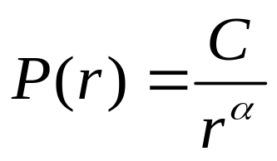
Zipf's Law
In 1932, linguistics expert Zipf[10] found that there are the word frequency in the descending order has the simple relationship that is the frequency of each word is inverse to the constant power of its ranking when he did some research on the English word frequency in Harvard University. In the formal, it can be expressed as below:
this is Zipf’s Law. Thereinto, C is a constant bigger than 0, usually is 1, is called Zipf exponential that is also a constant bigger than 0 and its value is decided by the detail case, in English is about 1.
2009.08.14
Institute of Information Engineering,Yangzhou University, Jiansu Yangzhou

Slide 6
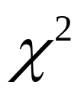
Classical Feature Extract Method
At present there are many feature extract algorithms, such as:
Document Frequency(DF),
Information Gain(IG) ,
Mutual Information(MI),
(CHI).
2009.08.14
Institute of Information Engineering,Yangzhou University, Jiansu Yangzhou

Slide 7
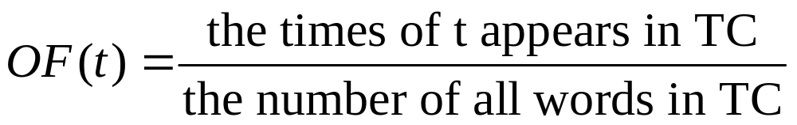
Feature Extract Strategy
Definition 1: In the whole training corpus(TC), the frequency of feature t in TC is called the Overall frequency(OF), defined as:
2009.08.14
Institute of Information Engineering,Yangzhou University, Jiansu Yangzhou

Slide 8
Feature Extract Strategy
After computing all features’ OF, a frequency-rank curve obtained according to all OF sorted by size is accord with the Zipf Law in most case. So we can enactment two threshold: the overall percentage of low-frequency feature(z-low) and the overall percentage of high-frequency feature(z-high) used for removed the lower z-low*number of all features and the higher z-high*number of all features separately, that is, reserve the features whose rank is between the two thresholds. In addition, after computing the document frequency(DF) of each feature, if the feature whose DF is less than certain threshold, it must be removed from the original feature space in this step.
2009.08.14
Institute of Information Engineering,Yangzhou University, Jiansu Yangzhou

Slide 9
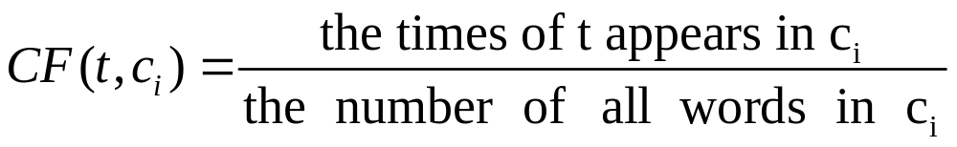
Feature Extract Strategy
Definition 2: In the whole training corpus(TC), the category set is C=(c1,c2,…, cm), m is the number of category, every text in TC has a category info ci ∈C, the frequency of feature t appears in the text belongs to ci ∈C is called as the category frequency(CF) of t, defined as: .
2009.08.14
Institute of Information Engineering,Yangzhou University, Jiansu Yangzhou

Slide 10
Feature Extract Strategy
If the feature t appears in the lesser categories and also have higher category frequency, it shows that the feature t has a special meaning for these categories which must be kept down; But if the feature t appears in the most categories and the category frequencies are very close, it shows that the feature t must be removed from feature space because of lower ability to distinguish categories. In the end, the features have bigger differentia among the category frequencies will be kept down.
2009.08.14
Institute of Information Engineering,Yangzhou University, Jiansu Yangzhou

Slide 11
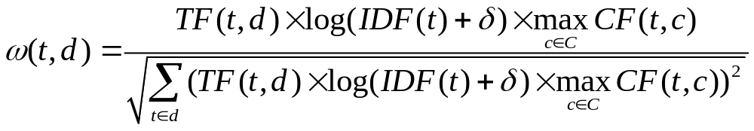
Text Classification Algorithm with an Effective Feature Extraction based on Category Analysis
The traditional formula TF-IDF shown in 2.3 is widely used in many classification systems or information retrieval systems in practice because of its simple computation. But the TF-IDF just takes TF and IDF into consideration without category frequency which is always important to text classification. Therefore, the paper advanced a improved feature weight formula, named as TF-IDF-CF:
2009.08.14
Institute of Information Engineering,Yangzhou University, Jiansu Yangzhou

Slide 12
Improved kNN Classification Algorithm
We advanced an text classification algorithm which is improved from the kNN^{[14]} after extracting the effective features by algorithm 2. The main idea is that, after extracting the useful features by algorithm 2 and computing the feature weight by formula TF-IDF-CF advanced in section 4.1, a target document vector space is build. Then a new document vector will be obtained from an unknown document in the test corpus the same way. At last, the K neighbors of new document will be found out then the category label obtained by counting these neighbors is as the category of the new document. Hereinto, the similarity of document vector is measured by the cosine similarity^{[15]}.
2009.08.14
Institute of Information Engineering,Yangzhou University, Jiansu Yangzhou

Slide 13
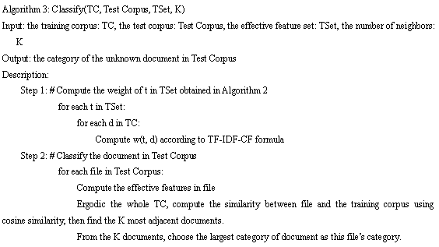
2009.08.14
Institute of Information Engineering,Yangzhou University, Jiansu Yangzhou

Slide 14
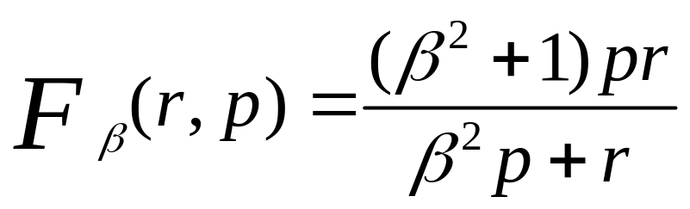
Experiments and Analysis
The paper adopt the international universal dataset named NewsGroup, which is consist of 19997 messages placard in Usenet. These messages belongs to twenty different news groups which have 1000 messages. Each news group corresponds to one text category. We adopt the whole data and chose 12000 texts as the training dataset and the rest is as test data.
recall(r) and precision(p)
F-guideline, defined as:
2009.08.14
Institute of Information Engineering,Yangzhou University, Jiansu Yangzhou

Slide 15
The arguments set up in the experiments are as follows:
The overall percentage of low-frequency: z-low is 1%;
The overall percentage of high-frequency: z-high is 1%;
DF threshold: df-threshold is 1%;
Category emergence rate: cf-rate is 90%;
Word frequency differentia threshold: cf-threshold is 0.0005;
The adjustment coefficient in TF-IDF-CF: is 0.01;
The number of neighbors: K is 500;
In the F-guideline, β is 1.
We got 88336 terms totally and have about 70000 effective features after the overall and partial feature extraction. Each document contains 56 effective features on average.
2009.08.14
Institute of Information Engineering,Yangzhou University, Jiansu Yangzhou

Slide 16
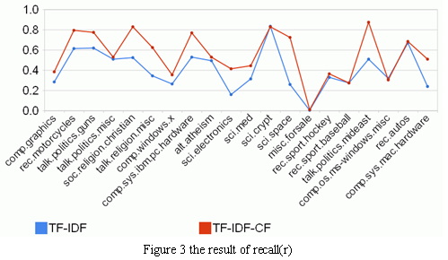
2009.08.14
Institute of Information Engineering,Yangzhou University, Jiansu Yangzhou

Slide 17
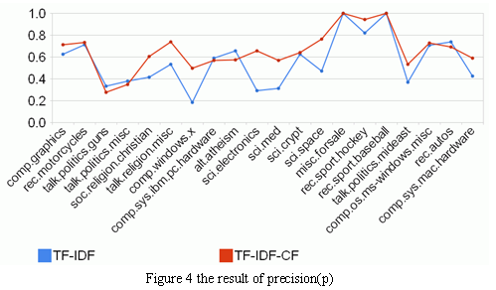
2009.08.14
Institute of Information Engineering,Yangzhou University, Jiansu Yangzhou

Slide 18
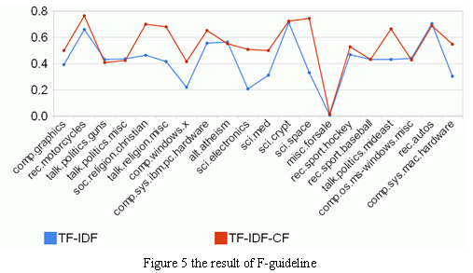
2009.08.14
Institute of Information Engineering,Yangzhou University, Jiansu Yangzhou

Slide 19
Summarize
This paper extracts the effective features from two level, that is overall and partial feature extraction. After obtaining the effective features, a new weight measurement named TF-IDF-CF is put forward based on the category frequency. Finally, the result of experiment shows that the feature extraction method advanced in the paper is more effective and can get higher classification accuracy.
2009.08.14
Institute of Information Engineering,Yangzhou University, Jiansu Yangzhou

Slide 20

Thanks~

